Slide 1
Type of computer
COMPUTER
PRESENTED BY :-
~Mohd. Farukh Khan
~Mantasha Naz
~Amaan Siddiqui

Slide 2
COMPUTER
Computer is an electronic device that is designed to work with Information.
It represents the decimal numbers through a string of binary digits
Charles Babbage is called the “Grand Father” of the computer. The First mechanical computer designed by Charles Babbage was called Analytical Engine

Slide 3
TYPE OF COMPUTER
We will discuss the type of computers on the basis of size and data handling capabilities. We will discuss each type of computer in detail.
Super Computer
Mainframe computer
Mini Computer
Personal Computer (PC)
Hybrid Computer
Tablets and Smartphone
Analog Computer
Digital computer

Slide 4
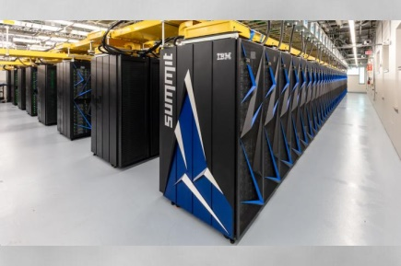
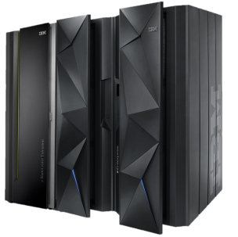
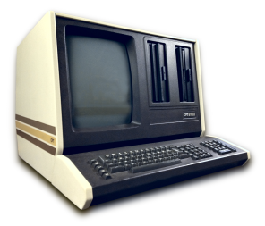
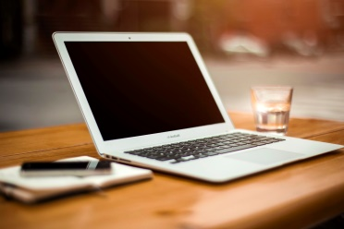
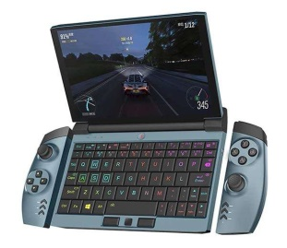
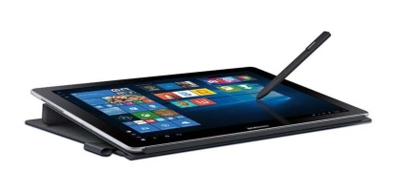
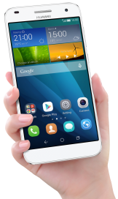
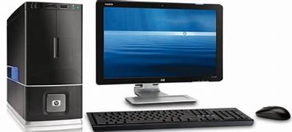
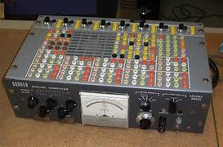
SUPERCOMPUTER MINICOMPUTER MAINFRAM COMPUTER
TABLETS PERSONAL COMPUTER HYBRID COMPUTER
SMARTPHONE DIGITAL COMPUTER ANALOG COMPUTER

Slide 5

SUPER COMPUTER
A supercomputer is an extremely powerful computing machine with high processing capabilities and speed. These computers are designed to handle complex and multiple tasks
Supercomputers often consist of thousands or even millions of processing units working together in parallel to solve problems

Slide 6
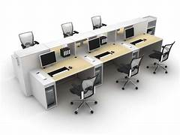
WORKSTATION COMPUTER
A workstation computer is designed for technical or scientific applications. It consists of a fast microprocessor, with a large amount of RAM and a high-speed graphic adapter. It is a single-user computer. It is generally used to perform a specific task with great accuracy.

Slide 7
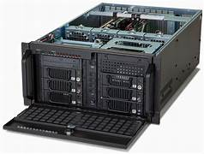
SERVER COMPUTER
Server Computers are computers that are combined data and programs. Electronic data and applications are stored and shared in the server computer.
The working of a server computer is that it does not solve a bigger problem like a supercomputer but it solves many smaller similar ones.

Slide 8
MINICOMPUTER
Minicomputer is a medium size multiprocessing computer. In this type of computer, there are two or more processors, and it supports 4 to 200 users at one time. Minicomputer is similar to Microcontroller.
It is smaller than a mainframe computer but larger in comparison to the microcomputer.

Slide 9
PERSONAL COMPUTER
Personal Computers is also known as a microcomputer. It is basically a general-purpose computer designed for individual use. It consists of a microprocessor as a central processing unit(CPU), memory, input unit, and output unit.
For example, Laptops and desktop computers.

Slide 10
MIANFRAM COMPUTER
Mainframe computers are designed in such a way that they can support hundreds or thousands of users at the same time. It also supports multiple programs simultaneously. So, they can execute different processes simultaneously. All these features make the mainframe computer ideal for big organizations like banking, telecom sectors, etc.

Slide 11

HYBRID COMPUTER
A hybrid computer is a type of computer that offers the functionalities of both a digital and an analog computer. It is designed to include a working analog unit that is powerful for calculations, yet has a readily available digital memory.

Slide 12
TABLETS AND SMARTPHONES
Tablets and Smartphones are the types of computers that are pocket friendly and easy to carry is these are handy. This is one of the best use of modern technology. These devices have better hardware capabilities, extensive operating systems, and better multimedia functionality. smartphones and tablets contain a number of sensors and are also able to provide wireless communication protocols.

Slide 13
ANALOG COMPUTER
An analog computer or analogue computer is a type of computer that uses the continuous variation aspect of physical phenomena such as electrical, mechanical, or hydraulic quantities (analog signals) to model the problem being solved.

Slide 14
THANK YOU…

